Slide 1

Modern Control Theory
Lecture No. 23
The Particle Filter in the Bayesian Framework
Assessment of Particle Filters, vis-à-vis Kalman Filters in the Bayesian Framework

Slide 2
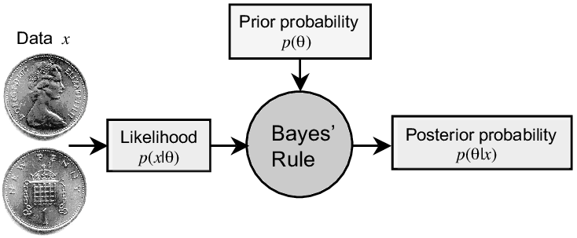
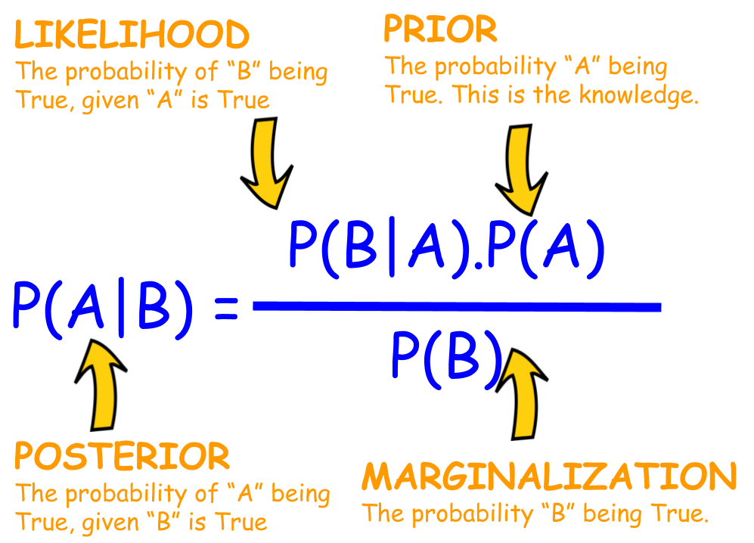

Slide 3
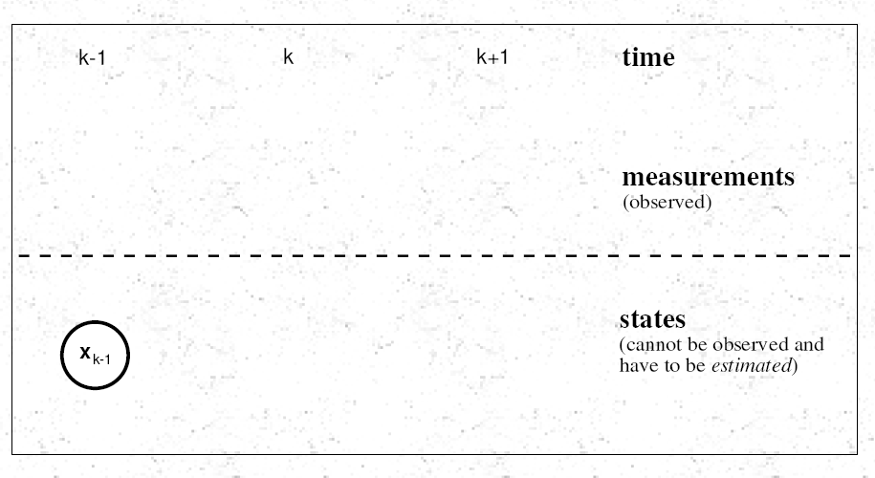
Propagating from (k-1) to (k) to (k+1)

Slide 4
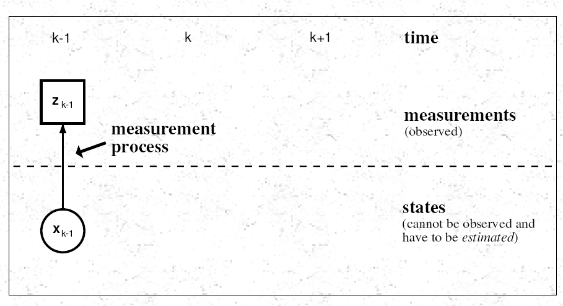

Slide 5
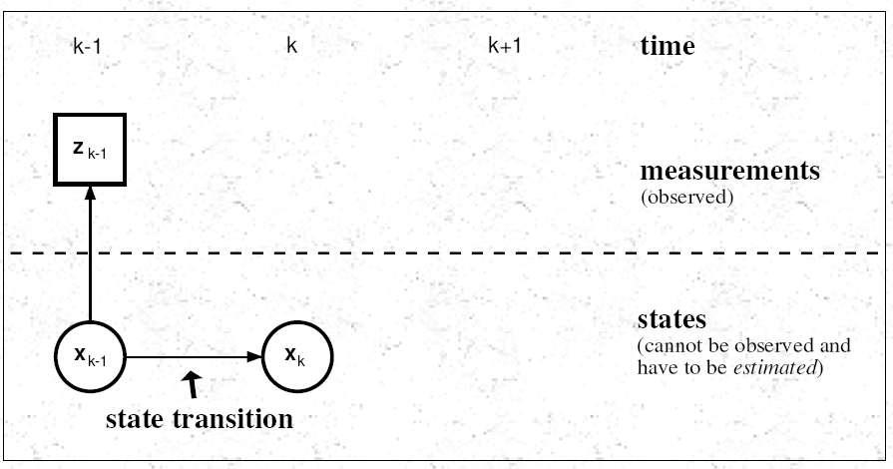

Slide 6
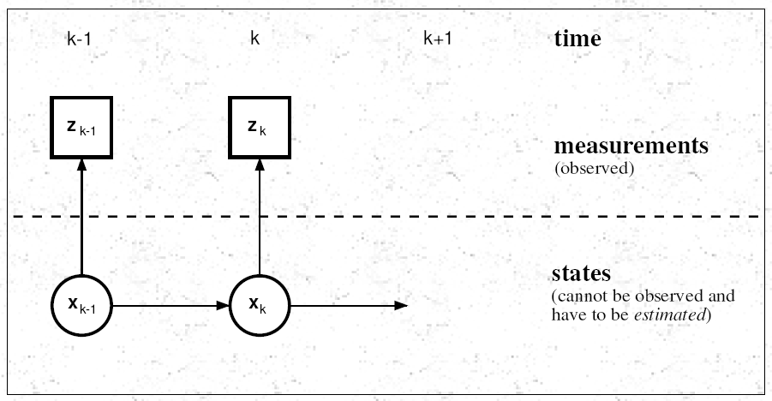

Slide 7
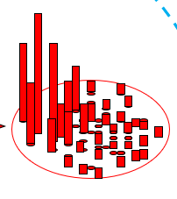
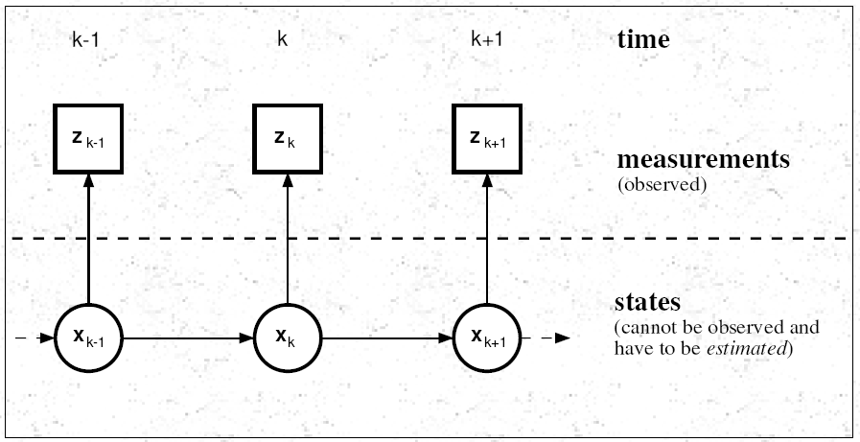
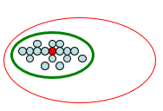

Slide 8
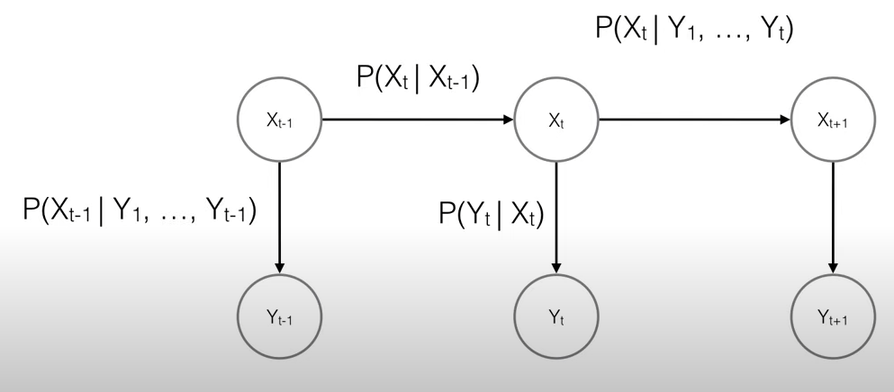
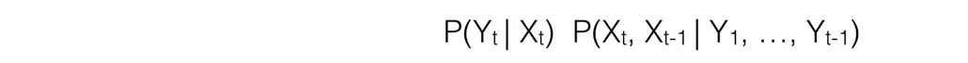


Slide 9
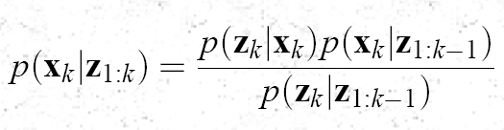


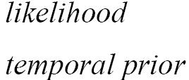

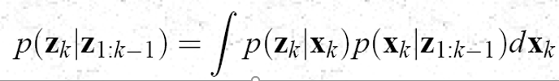
Review of
Re-structure of the Posterior Equation

Slide 10

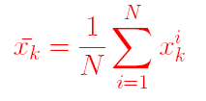



Review of Sequential Importance Re-sampling/Particle Filter

Slide 11
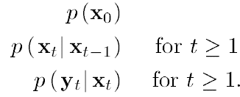

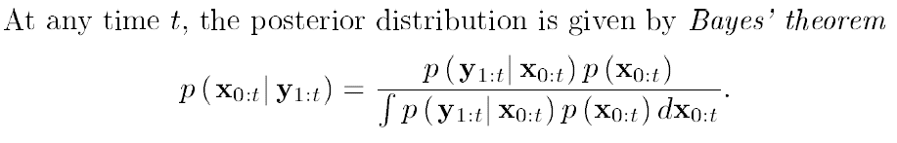

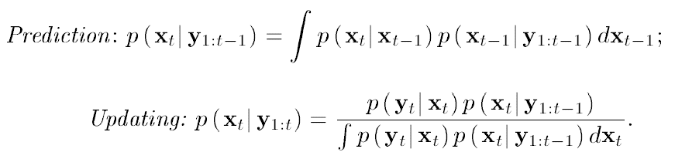
The Bayesian Approach for the Posterior

Slide 12
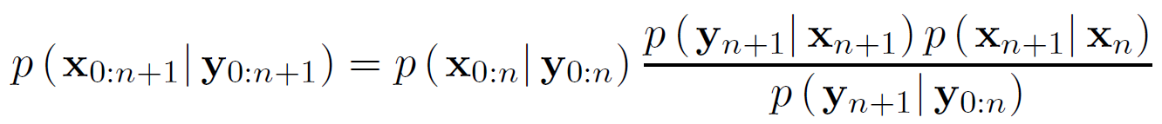
Recursive Posterior

Slide 13
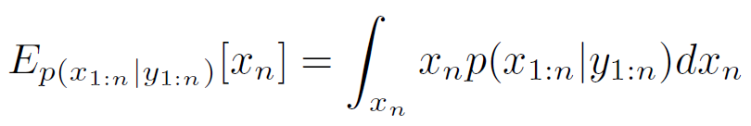
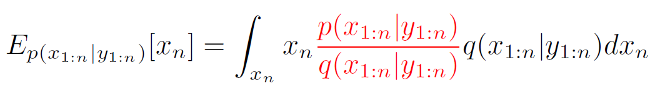

Importance Sampling & Weights

Slide 14
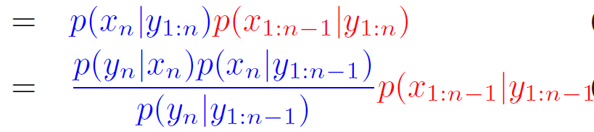
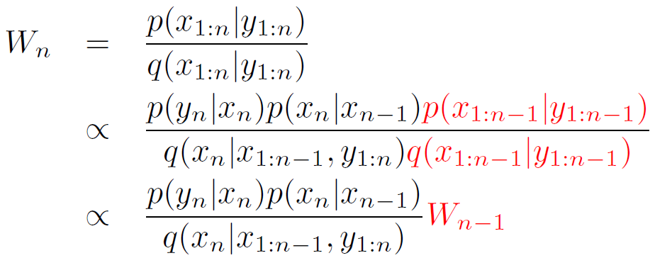
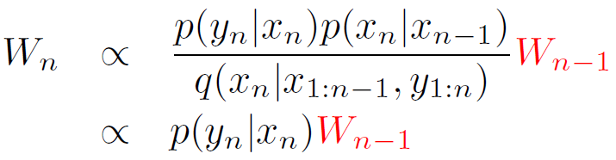
Weights & Likelihood Function

Slide 15

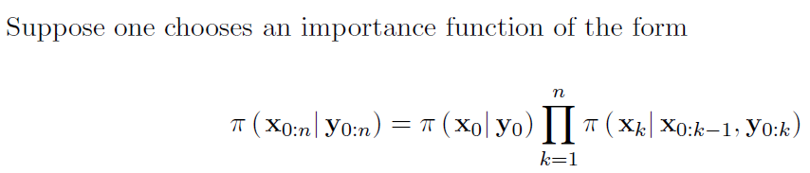


Slide 16
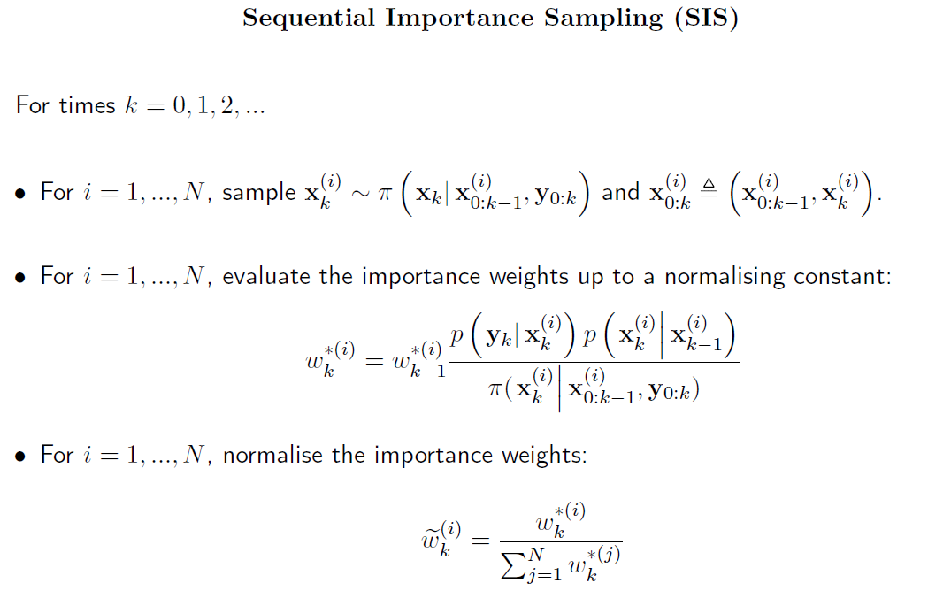
Sequential Importance Sampling

Slide 17
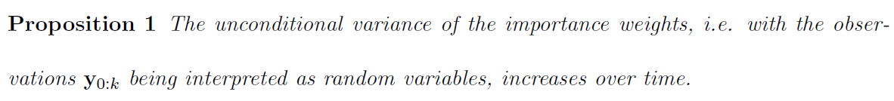
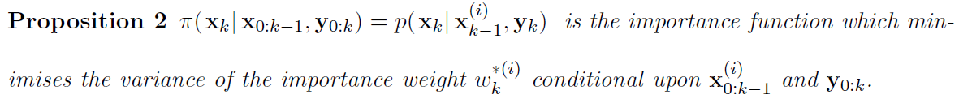
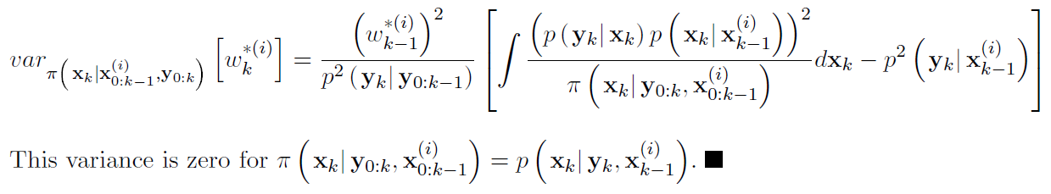

More on the Importance Weights

Slide 18



Resampling
Dist. Of
Predicted States
Corresponding
Weights
Posterior Density
Function after
Re-sampling
Particles having
Low Weights
are Rejected &
Particles having
High Weights
are Retained/
Replicated
Shape of the Density
Function before
Re-sampling
(Predicted Estimates)
Shape of the Density
Function after
Re-sampling
(Updated Estimates)

Slide 19
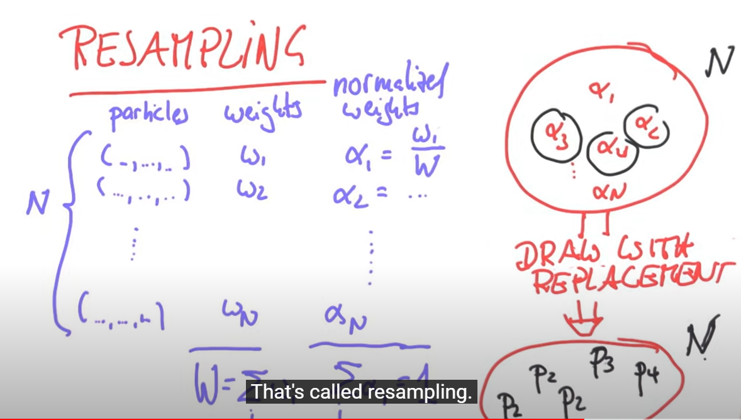
Snapshot-1

Slide 20
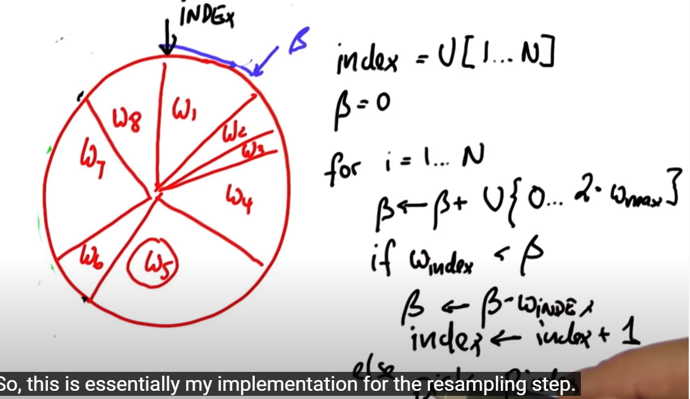
Snapshot-2

Slide 21
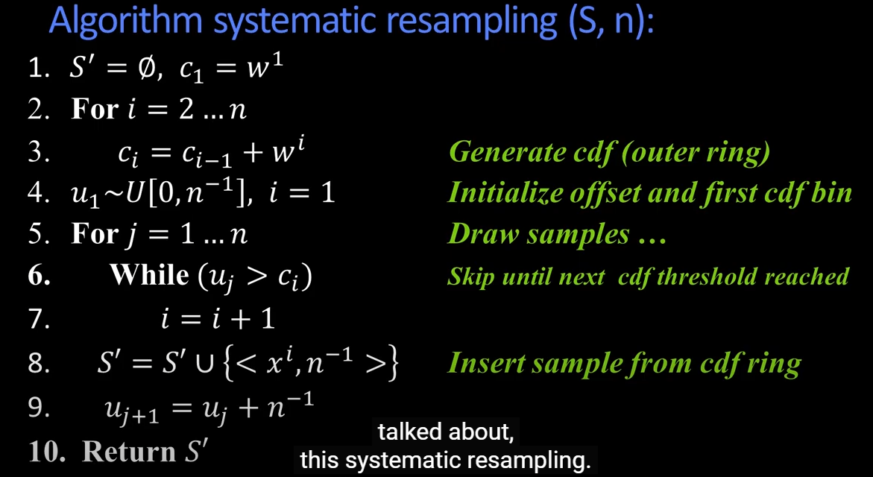
Snapshot-3

Slide 22
Sequential Importance Re-sampling/Particle Filter

